Slide 1
JUST Connect
Created by Amy Fisher

Slide 2
Player Instructions
If incorrect, the other team has a chance to guess. (Host should reveal the rest of the clues if not already shown.)
If they get it correct, they earn 1 point.
Teams switch, second team has a turn to guess.
Game continues for Round 1 and 2 in this fashion.
For Round 3, everyone is on the Stage (or Lobby) and connects to buzzin.live with the Host creating a room and sharing the code.
First person to buzz in with the correct answer gets one point for their team.
No deduction of points for wrong answers
Team with the most points wins!
Split up the players into two teams.
Decide on a team captain for each team. They will say ‘Next’ and give final answers.
Rock Paper Scissors between team captains to decide which team goes first.
Each team takes turns guessing first on Connections and Sequences
Say ‘Next’ to see the next clue. (Host clicks spacebar to show next clue)
Talk amongst your team to decide on the best answer.
Team captain will say “Ding!” to buzz in and announce their final guess.
If correct, that team gets the number of points displayed on the game screen.

Slide 3
Find the Connection
In this round, you can see up to 4 clues. I want to know what connects them.
If you can tell me the answer after only one clue, you’ll get an incredible 5 points. After two clues, you’ll get 3 points, three clues gets you 2 points, and all 4 will give you 1 point.
If you give a wrong answer or don’t answer at all, I’ll give it to the other team for a bonus.

Slide 4

Round 1 – FIND the connection
5 Points
3 Points
2 Points
1 Point
Mustard
Peacock
Plum
Scarlet
Get Ready!
Clue Characters
10 SECOND WARNING
TIME’S UP!

Slide 5
Round 1 – FIND the connection
5 Points
3 Points
2 Points
1 Point
Fiji
Voss
Evian
Aquafina
Get Ready!
Water Bottle Brands
10 SECOND WARNING
TIME’S UP!

Slide 6
Round 1 – FIND the connection
5 Points
3 Points
2 Points
1 Point
Humuhumunukunukuāpuaʻa
Slimehead
Lumpsucker
Pirate Perch
Get Ready!
Types of Fish
10 SECOND WARNING
TIME’S UP!

Slide 7
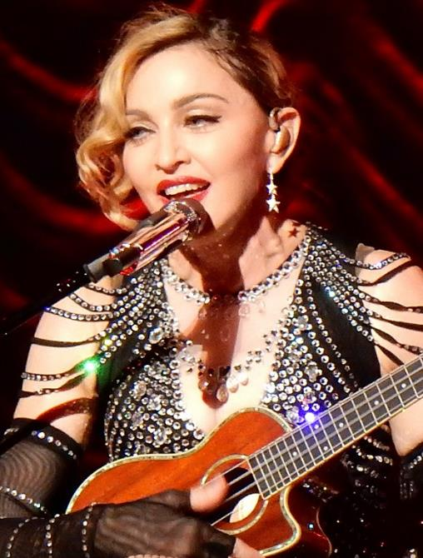
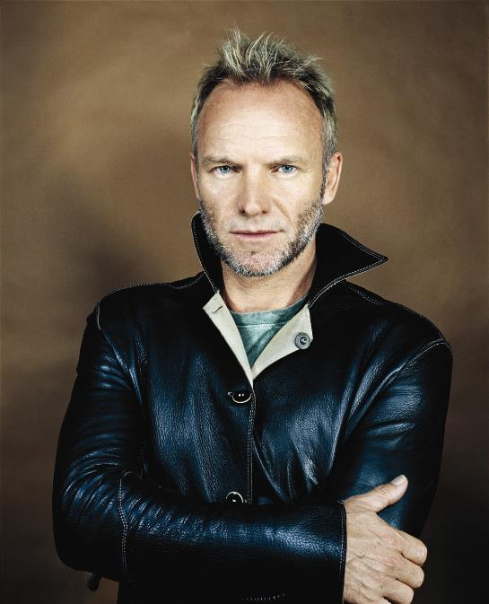
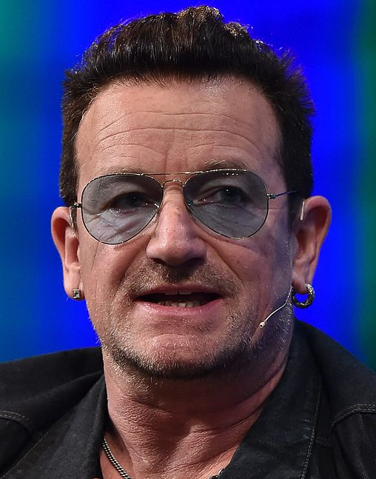
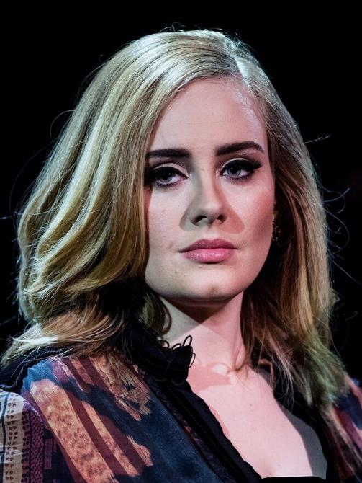
Round 1 – FIND the connection
5 Points
3 Points
2 Points
1 Point
Picture Question:
Get Ready!
Bono
Madonna
Sting
Adele
One-Named Celebrities
10 SECOND WARNING
TIME’S UP!
This Photo by Unknown Author is licensed under CC BY-SA
This Photo by Unknown Author is licensed under CC BY-SA
This Photo by Unknown Author is licensed under CC BY-NC
This Photo by Unknown Author is licensed under CC BY-NC

Slide 8
Round 1 – FIND the connection
5 Points
3 Points
2 Points
1 Point
Bin
Dat
Zip
Exe
Get Ready!
File Extensions
10 SECOND WARNING
TIME’S UP!

Slide 9
Round 1 – FIND the connection
5 Points
3 Points
2 Points
1 Point
The Forks
Peace
Victory
Rabbit Ears
Get Ready!
All Represented by V sign – 2 Fingers
10 SECOND WARNING
TIME’S UP!

Slide 10
Round 1 – FIND the connection
5 Points
3 Points
2 Points
1 Point
Japanese
New School
Classic Americana
Stick and Poke
Get Ready!
Styles of Tattooing
10 SECOND WARNING
TIME’S UP!

Slide 11
Round 1 – FIND the connection
5 Points
3 Points
2 Points
1 Point
Walk
Steal
Bunt
Inning
Get Ready!
Baseball Terminology
10 SECOND WARNING
TIME’S UP!

Slide 12
Round 1 – FIND the connection
5 Points
3 Points
2 Points
1 Point
Holy
Yummy
Sorry
Baby
Get Ready!
Justin Bieber Singles
10 SECOND WARNING
TIME’S UP!

Slide 13
Round 1 – FIND the connection
5 Points
3 Points
2 Points
1 Point
Robert H. Lawrence, Jr
Jackie Robinson
Oprah Winfrey
Barack Obama
Get Ready!
First African Americans
10 SECOND WARNING
TIME’S UP!

Slide 14
Round 1 – FIND the connection
5 Points
3 Points
2 Points
1 Point
Golden Gate Bridge
Black Box on Planes
Donald Trump
Pumpkins
Get Ready!
Things that are Orange
10 SECOND WARNING
TIME’S UP!

Slide 15
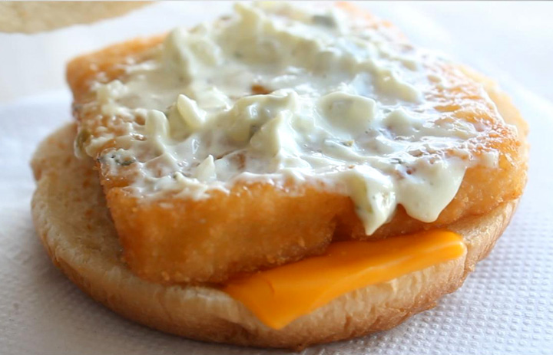
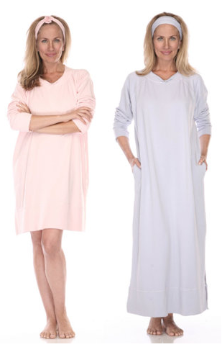
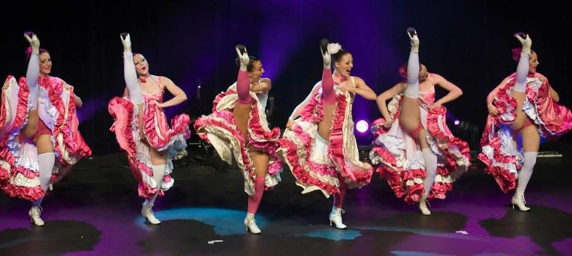
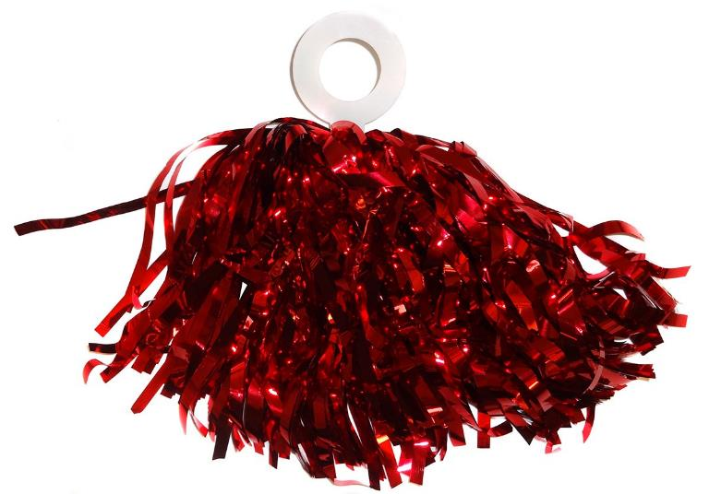
Round 1 – FIND the connection
5 Points
3 Points
2 Points
1 Point
Picture Question:
Get Ready!
MUUMUU
TARTAR
CANCAN
POMPOM
Two Words Repeated to make 6-letter Word
10 SECOND WARNING
TIME’S UP!
This Photo by Unknown Author is licensed under CC BY
This Photo by Unknown Author is licensed under CC BY
This Photo by Unknown Author is licensed under CC BY-NC
This Photo by Unknown Author is licensed under CC BY-NC

Slide 16
Find the Sequence
In this round, you can see up to 3 clues. I want to know what comes 4th in the sequence.
If you can tell me the answer after only one clue, you’ll get an incredible 5 points. After two clues, you’ll get 3 points, three clues gets you 2 points.
If you give a wrong answer or don’t answer at all, I’ll give it to the other team for a bonus point.

Slide 17
Round 2 – FIND the fourth in the Sequence
5 Points
3 Points
2 Points
1 Point
Leap
Black History
Holy
Christmas
?
Get Ready!
Year, Month, Week, Day
10 SECOND WARNING
TIME’S UP!

Slide 18
Round 2 – FIND the fourth in the Sequence
5 Points
3 Points
2 Points
1 Point
Jump to the Left
Step to the Right
Put your hands on your hips
Bring your knees in tight
?
Get Ready!
Time Warp Dance
10 SECOND WARNING
TIME’S UP!

Slide 19
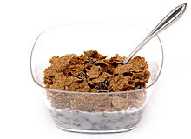
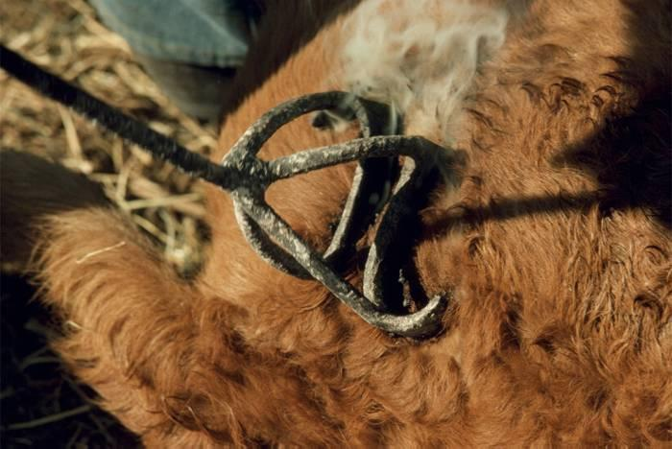
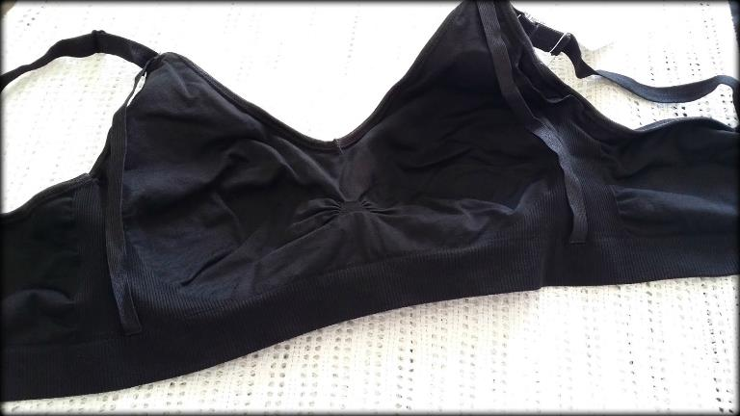

Round 2 – FIND the FOURTH IN THE SEQUENCE
5 Points
3 Points
2 Points
1 Point
?
Picture Question:
Get Ready!
BRA
BRAN
BRAND
BRANDY
Bra to Brandy
10 SECOND WARNING
TIME’S UP!
This Photo by Unknown Author is licensed under CC BY-NC-ND
This Photo by Unknown Author is licensed under CC BY-NC-ND

Slide 20
Round 2 – FIND the fourth in the Sequence
5 Points
3 Points
2 Points
1 Point
AB
B
A
O
?
Get Ready!
Least to Most Common Blood Typs
10 SECOND WARNING
TIME’S UP!

Slide 21
Round 2 – FIND the fourth in the Sequence
5 Points
3 Points
2 Points
1 Point
86
75
30
9
?
Get Ready!
867-5309 Phone Number
10 SECOND WARNING
TIME’S UP!

Slide 22
Round 2 – FIND the fourth in the Sequence
5 Points
3 Points
2 Points
1 Point
1st five
2nd six
3rd five
4th six
?
Get Ready!
Number of Letters in 1st, 2nd, 3rd, 4th
10 SECOND WARNING
TIME’S UP!

Slide 23
Round 2 – FIND the fourth in the Sequence
5 Points
3 Points
2 Points
1 Point
Oklahoma
(to the north)
Arkansas and Louisiana
(to the east)
Mexico
(to the south)
New Mexico
(to the west)
?
Get Ready!
States bordering Texas
10 SECOND WARNING
TIME’S UP!

Slide 24
Round 2 – FIND the fourth in the Sequence
5 Points
3 Points
2 Points
1 Point
Phantom
Attack
Revenge
New
?
Get Ready!
Star Wars Movies – chronological order
10 SECOND WARNING
TIME’S UP!

Slide 25
Round 2 – FIND the fourth in the Sequence
5 Points
3 Points
2 Points
1 Point
625
125
25
5
?
Get Ready!
Five to Powers of 4 through 1
10 SECOND WARNING
TIME’S UP!

Slide 26
Round 2 – FIND the fourth in the Sequence
5 Points
3 Points
2 Points
1 Point
Adams (2nd)
Adams (6th)
Arthur (21st)
Biden (46th)
?
Get Ready!
Alphabetical Presidents
10 SECOND WARNING
TIME’S UP!

Slide 27
Round 2 – FIND the fourth in the Sequence
5 Points
3 Points
2 Points
1 Point
1 – Sounds like 2 words
2 – Sounds like 3 words
3 – Sounds like only one word
4 – Sounds like 3 words
?
Get Ready!
Homophones of Numbers
10 SECOND WARNING
TIME’S UP!

Slide 28
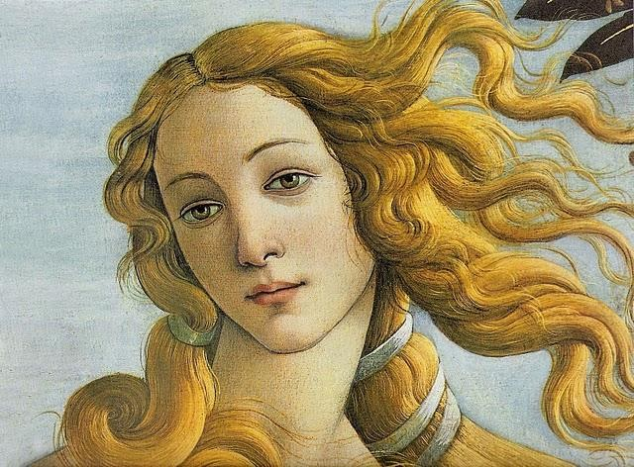
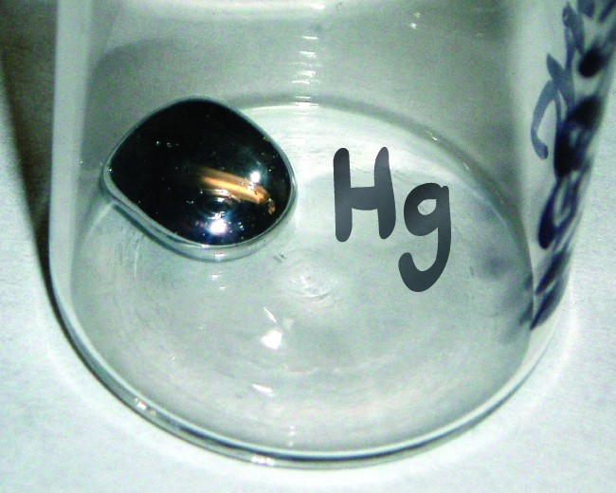
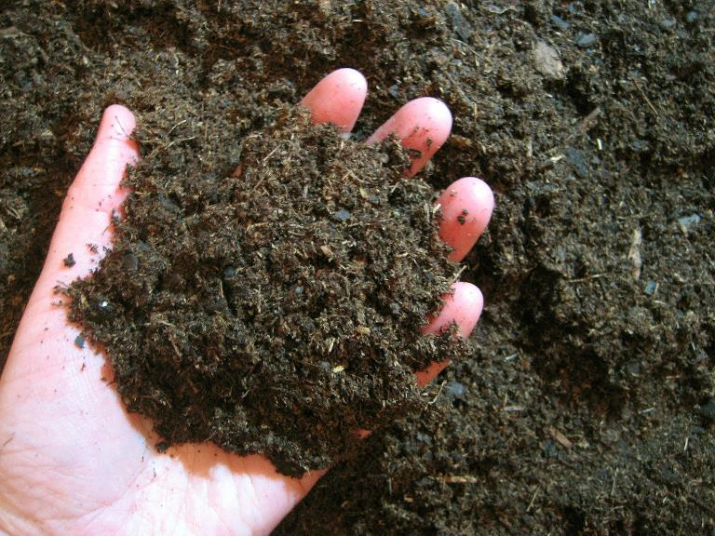

Round 2 – FIND the FOURTH IN THE SEQUENCE
5 Points
3 Points
2 Points
1 Point
?
Picture Question:
Get Ready!
Mercury
Venus
Earth
Mars
Planets
10 SECOND WARNING
TIME’S UP!

Slide 29
Missing Vowels Round
In this round, you are told the connection, but must tell me the clues
We’ve taken well-known phrases, removed the vowels, and squished up the consonants with random spaces.
Login to buzzin.live with the host’s code. Buzz in when you know the answer. No deducted points for wrong answers.
Everyone plays on their own, so fingers at the ready…

Slide 30
Round 3 – missing vowels
JS SCH RST S PRS TR
JESUS CHRIST SUPERSTAR
Musicals

Slide 31
Round 3 – missing vowels
WCKD
WICKED
Musicals

Slide 32
Round 3 – missing vowels
HM L TN
HAMILTON
Musicals

Slide 33
Round 3 – missing vowels
RN T
RENT
Musicals

Slide 34
Round 3 – missing vowels
TSL
TESLA
Car Brands

Slide 35
Round 3 – missing vowels
S BR
SUBARU
Car Brands

Slide 36
Round 3 – missing vowels
K
KIA
Car Brands

Slide 37
Round 3 – missing vowels
D
AUDI
Car Brands

Slide 38
Round 3 – missing vowels
CL N T R
CILANTRO
Herbs

Slide 39
Round 3 – missing vowels
BS L
BASIL
Herbs

Slide 40
Round 3 – missing vowels
S G
SAGE
Herbs

Slide 41
Round 3 – missing vowels
R GN
OREGANO
Herbs

Slide 42
Round 3 – missing vowels
C HM L N
CHAMELEON
Colorful Animals

Slide 43
Round 3 – missing vowels
MN DR LL
MANDRILL
Colorful Animals

Slide 44
Round 3 – missing vowels
PC CK
PEACOCK
Colorful Animals

Slide 45
Round 3 – missing vowels
TC N
TOUCAN
Colorful Animals

Slide 46
Round 3 – missing vowels
VN
OVEN
Appliances

Slide 47
Round 3 – missing vowels
B LND R
BLENDER
Appliances

Slide 48
Round 3 – missing vowels
WS HNGM CHN
WASHING MACHINE
Appliances

Slide 49
Round 3 – missing vowels
S T V
STOVE
Appliances

Slide 50
Round 3 – missing vowels
LN CLN
LINCOLN
Presidents

Slide 51
Round 3 – missing vowels
MNR
MONROE
Presidents

Slide 52
Round 3 – missing vowels
RGN
REAGAN
Presidents

Slide 53
Round 3 – missing vowels
S NH WR
EISENHOWER
Presidents

Slide 54
Round 3 – missing vowels
BM
OBAMA
Presidents

Slide 55
CREDITS
Inspiration from Only Connect on BBC4
Music Attribution:
Half Mystery by Kevin MacLeod
Link: https://incompetech.filmmusic.io/song/5026-half-mystery
License: https://filmmusic.io/standard-license
Page Flip Sound:
Paper Flip by gynation
This work is licensed under the Creative Commons 0 License.

